Slide 1
Manage Security for Azure SQL Database
Module 4
Notes:
We are continuing with the Azure SQL Database Essentials course. Here we will explore the management of security of the Azure SQL database on the Microsoft Azure cloud platform.

Slide 3
Learning Units covered in this Module
Lesson 1: Introduction to Azure SQL Database Security
Lesson 2: Implement Azure Active Directory Security
Lesson 3: Manage Logins in Azure SQL Database
Lesson 4: Implement Firewall Rules and Virtual Networks
Lesson 5: Implement Transparent Data Encryption
Lesson 6: Implement Always Encrypted
Lesson 7: Implement Row Level Security
Lesson 8: Implement Dynamic Data Masking
Lesson 9: Implement Auditing for Azure SQL Database
Lesson 10: Implement Advanced Data Security
Notes:
There are ten lessons in this module.

Slide 4
Lesson 1: Introduction to Azure SQL Database Security
Notes:
In this lesson we will be covering Azure SQL Database Security.

Slide 5

Objectives
After completing this learning, you will be able to:
Know the various options to manage security for an Azure SQL Database.
Notes:
In this lesson we will be covering Azure SQL Database Security.

Slide 6
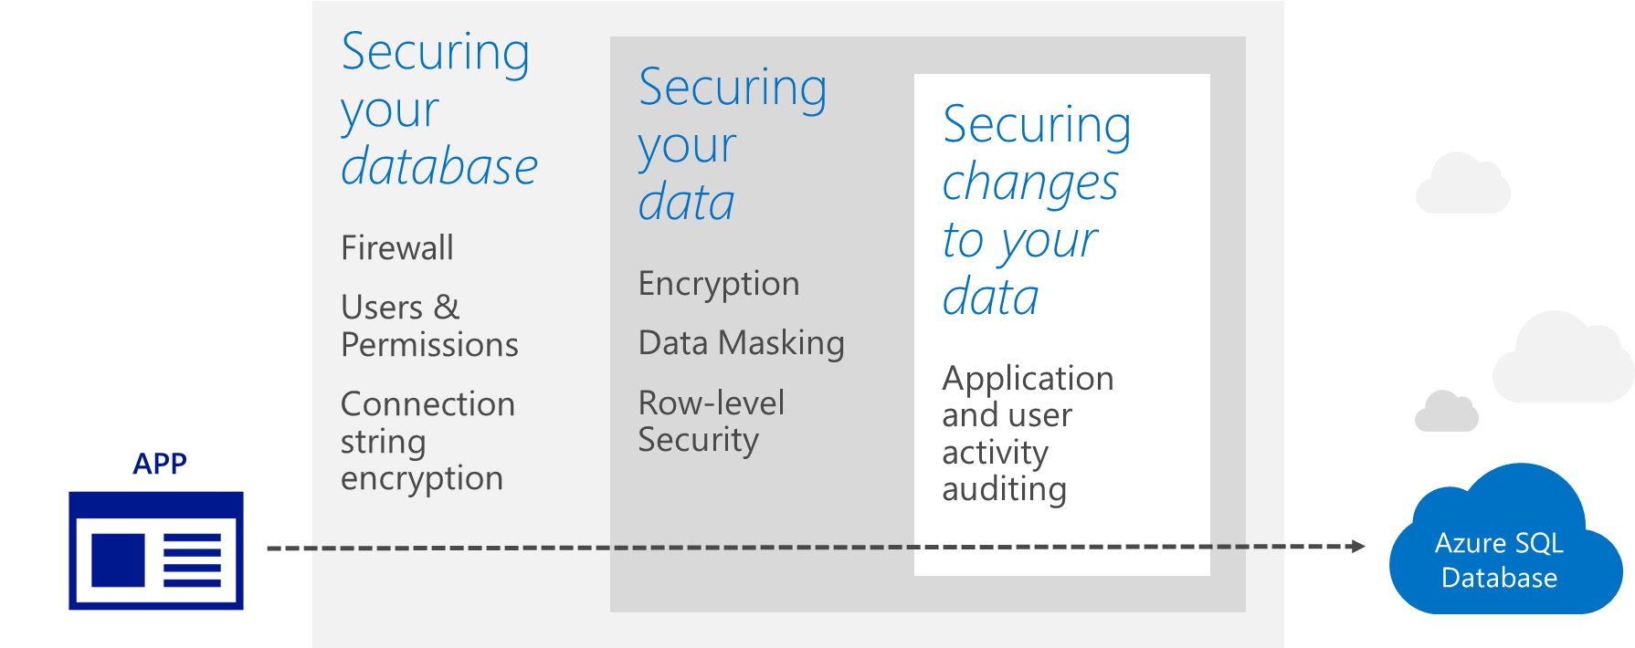
Azure SQL Database Security Layers
Notes:
As in most security solutions, Azure SQL Database supports a multi-layer security approach which includes firewall technology, encryption strategies, role-based access control and other features.

Slide 7
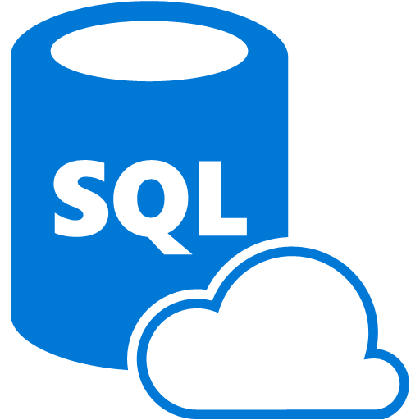
Security Features for Azure SQL DB
Sessions
Encryption
Azure Active Directory Security
Firewall
Data protection
TDE
Always Encrypted
Analysis
Row-level security
Dynamic data masking
SQL Auditing
Threat Detection
Notes:
Additional special security features are available in Azure SQL Database which include Azure Active Directory security, Transparent Data Encryption (TDE), Always Encrypted, Row-level security, Dynamic data masking, SQL Auditing and common Threat Detection. We will be covering each of these features in later lessons.

Slide 8
Types of data encryption
Data encryption | Encryption technology | Customer value
In transit | Transport Layer Security (TLS) from the client to the server. | Protects data between client and server against snooping and man-in-the-middle attacks. NOTE: Azure SQL Database is phasing out Secure Sockets Layer (SSL) 3.0 and TLS 1.0 in favor of TLS 1.2.
At rest | Transparent Data Encryption (TDE) for Azure SQL Database. | Protects data on the disk. Key management is done by Azure, which makes it easier to obtain compliance.
In use (end-to-end) | Always Encrypted for client-side column encryption. | Data is protected end-to-end, but the application is aware of encrypted columns. This is used in the absence of data masking and TDE for compliance-related scenarios.
In use
In transit
At rest
Column encryption
Customer data
Database files, backups, Tx log, TempDB
Notes:
Objective: Azure SQL includes a number of additional security measures for data. This slide provides an overview of SQL encryption in transit, at rest, and end-to-end.
Talking Points:
Key takeaway: Encrypted sensitive data and its corresponding keys are never seen in plain text in SQL Server
The customer will need to verify in the Azure Portal that the database is encrypted via PowerShell/T-SQL
Encryption-In-Transit technologies:
TLS from Client to Server
TLS = Transport Layer Security
Encryption at rest technologies:
TDE for SQL Database. On by default for newly deployed Azure SQL Databases. Note: TDE needs to be manually enabled for Azure SQL Managed Instance, older databases of Azure SQL Database, or Azure SQL Data Warehouse
TDE = Transparent Data Encryption
End-To-End encryption technologies:
Client-side column encryption for SQL Database (library available for download)

Slide 9

Questions?

Slide 10
Knowledge Check
List the security features available for Azure SQL Database.
Name the feature to encrypt the data both at rest and motion.
Notes:
Q1: List the security features available for Azure SQL Database?
Answer 1:
TDE, Always Encrypted, Row Level Security , Dynamic Data masking etc.
Q2: Name the feature to encrypt the data both at rest and motion.
Answer 2: Always Encrypted.

Slide 11
Lesson 2: Implement Azure Active Directory Security
Notes:
In this lesson we will be covering Azure Active Directory Security.

Slide 12
Objectives
After completing this learning, you will be able to:
Know how to leverage Azure Active Directory security for authenticating connections to an Azure SQL Database.
Notes:
In this lesson we will be covering Azure Active Directory Security.

Slide 13
Azure Active Directory(AAD) Security
Azure Active Directory authentication is a mechanism of connecting to Microsoft Azure SQL Database by using identities in Azure Active Directory (Azure AD)
Azure SQL Database
Customer 1
Customer 2
Customer 3
Notes:
Azure Active Directory (AAD) is a cloud-compliant directory services product that provides identity and authentication services for cloud applications including data security integration with Azure SQL Database.
Configure and manage Azure Active Directory authentication with SQL:
https://docs.microsoft.com/en-us/azure/sql-database/sql-database-aad-authentication-configure

Slide 14
Three Types of AAD Authentication
Active Directory Integrated Authentication.
Active Directory Password Authentication.
Active Directory Universal with MFA Authentication.
Notes:
Active Directory Integrated Authentication – Azure AD provides Integrated Windows Authentication for Azure AD federated domains and clients on domain-joined machines. This enables single sign-on across participating services. Integrated Windows authentication is also supported for remote connections using VPNs.
Active Directory Password Authentication – Azure AD supports managed and federated domains with user name/password. Password rotation is centralized and triggered automatically from Azure AD
Active Directory Universal with MFA authentication is an interactive method that also supports Azure Multi-Factor Authentication (MFA). Azure MFA helps safeguard access to data and applications while meeting user demand for a simple sign-in process. It delivers strong authentication with a range of easy verification options (phone call, text message, smart cards with pin, or mobile app notification), allowing users to choose the method they prefer. Interactive MFA with Azure AD can result in a pop-up dialog box for MFA validation.

Slide 15
Benefits of AAD Authentication
Centrally manage user permissions.
Alternative to SQL Server authentication.
Allows password rotation in a single place.
Enables management of database permissions using external Azure Active Directory groups.
Stops password storing by using integrated Windows authentication and other forms of authentication supported by AAD.
Notes:
Azure Active Directory authentication is a mechanism of connecting to Microsoft Azure SQL Database by using identities in Azure Active Directory (AAD). With AAD authentication you can centrally manage the identities of database users and other Microsoft services in one central location. Central ID management provides a single place to manage database users and simplifies permission management. Benefits include the following:
It provides an alternative to SQL Server authentication.
Helps stop the proliferation of user identities across database servers.
Allows password rotation in a single place
Customers can manage database permissions using external AAD groups.
It can eliminate storing passwords by enabling integrated Windows authentication and other forms of authentication supported by AAD.
AAD authentication uses contained database users to authenticate identities at the database level.
AAD supports token-based authentication for applications connecting to SQL Database.

Slide 16
Trust architecture
Azure Active Directory and Azure SQL Database
On-premises active directory
ADFS
Azure Active Directory
Azure SQL Database
SQL Server Management Suite
ADALSQL
ADO .NET 4.6
SQL Server Data Tools
Azure Active Directory Authentication Library for SQL Server (ADALSQL)
App
Notes:
AAD supports token-based (also known as “claim-based”) authentication for applications connecting to SQL Database. The Trust architecture is designed to enable the transportation of secure tokens used for claim-based authentication instead of passing credentials between application components. This gives added security and performance benefits reducing round-trips with AAD.
With Azure Active Directory authentication you can centrally manage the identities of database users and other Microsoft services in one central location. Central ID management provides a single place to manage database users and simplifies permission management. Benefits include the following:
It provides an alternative to SQL Server authentication.
Helps stop the proliferation of user identities across database servers.
Allows password rotation in a single place
Customers can manage database permissions using external (AAD) groups.
It can eliminate storing passwords by enabling integrated Windows authentication and other forms of authentication supported by Azure Active Directory.
Azure Active Directory authentication uses contained database users to authenticate identities at the database level.
Azure Active Directory supports token-based authentication for applications token-based authentication for applications connecting to SQL Database.

Slide 17

Demonstration
Implement AAD Authentication
Connect to Azure Active Directory.
Connect to Azure SQL DB using SSMS through AAD authentication.
Notes:
M04L02Demo01
Demo requirements
None
FYI There is no lab for this because many students are using a Microsoft Account without a domain, so they cannot perform this lab.
In this demo your going to setup your Microsoft Account as Administrator of the logical server.
Once the Administrator has been setup, you will show that it’s possible to connect with the SSMS using your windows account
Demo 1 – Create Admin Account:
Open the Azure Portal and go to your logical server
Click on Active Directory Admin
Click on Set Admin
Type your Microsoft Alias and select it as the admin account
Click Save
Demo 2 – Connect with SSMS
Open SSMS, specify your logical server name and select “Active Directory – Universal with MFA support”
Specify your username, which is your Microsoft Account
Click Connect

Slide 18
Questions?

Slide 19
Knowledge Check
List three benefits of Azure Activity Directory Authentication.
Can we use Windows authentication for Azure SQL Database?
Notes:
Q1: List three benefits of Azure Activity Directory Authentication.
Answer 1:
Centrally manage user permissions, allows password rotation in single place and stops password storing by using active directory integrated authentication.
Q2: Can we use Windows authentication for Azure SQL Database?
Answer 2:
No, it's not supported. Instead you need to use AAD Authentication.

Slide 20
Lesson 3: Manage Logins in Azure SQL Database
Notes:
In this lesson we will be covering Management of Logins in Azure SQL Database

Slide 21
Objectives
After completing this learning, you will be able to:
Manage logins within Azure SQL Database.
Notes:
In this lesson we will be covering Management of Logins in Azure SQL Database

Slide 22
Unrestricted Administrative Accounts
Server Level Principal accounts
Server Admin
Azure Active Directory Administrator
Notes:
Server admin When you create an Azure SQL server, you must designate a Server admin login. SQL server creates that account as a login in the master database. This account connects using SQL Server authentication (user name and password). Only one of these accounts can exist.
Azure Active Directory admin One Azure Active Directory account, either an individual or security group account, can also be configured as an administrator. It is optional to configure an Azure AD administrator, but an Azure AD administrator must be configured if you want to use Azure AD accounts to connect to SQL Database.
The Server admin and Azure AD admin accounts has the following characteristics:
These are the only accounts that can automatically connect to any SQL Database on the server. (To connect to a user database, other accounts must either be the owner of the database, or have a user account in the user database.)
These accounts enter user databases as the dbo user and they have all the permissions in the user databases. (The owner of a user database also enters the database as the dbo user.)
These accounts do not enter the master database as the dbo user and they have limited permissions in master.
These accounts are not members of the standard SQL Server sysadmin fixed server role, which is not available in SQL database.
These accounts can create, alter, and drop databases, logins, users in master, and server-level firewall rules.
These accounts can add and remove members to the dbmanager and loginmanager roles.
These accounts can view the sys.sql_logins system table.

Slide 23
Administrator Access Path
Azure Active Directory
Azure Active Directory admin
A single account (can be a user or group)
Optional if not using Azure Active Directory Authentication
Required if using Azure Active Directory Authentication
Master database
Uses Active Directory Authentication
Uses SQL Server Authentication
SQL Server Admin Account
Server-level Firewall
Notes:
Administrator access path
When the server-level firewall is properly configured, the SQL server admin and the Azure Active Directory admin can connect using client tools such as SQL Server Management Studio or SQL Server Data Tools. Only the latest tools provide all the features and capabilities.
When using an open port in the server-level firewall, administrators can connect to any SQL Database.

Slide 24
Additional Special Roles
Database Creators
ALTER ROLE dbmanager* ADD MEMBER Mary;
ALTER ROLE dbmanager* ADD MEMBER [mike@contoso.com];
Create a server-level login
Create a user in virtual master
Add to dbmanager
*dbmanager is a database role in virtual master database.
Notes:
Members of this role can create new databases. To use this role, you create a user in the master database and then add the user to the dbmanager database role.
To use this role, you create a user in the master database and then add the user to the dbmanager database role. To create a database, the user must be a user based on a SQL Server login in the master database or contained database user based on an Azure Active Directory user.

Slide 25
Additional Special Roles (continued)
Login Managers
ALTER ROLE loginmanager* ADD MEMBER Mary;
ALTER ROLE loginmanager* ADD MEMBER [mike@contoso.com];
Create a server-level login
Create a user in virtual master or contained user (preferred)
Add to loginmanager
*loginmanager is a database role in virtual master database.
Notes:
Login managers
The other administrative role is the login manager role. Members of this role can create new logins in the master database. If you wish, you can complete the same steps (create a login and user and add a user to the loginmanager role) to enable a user to create new logins in the master. Usually logins are not necessary as Microsoft recommends using contained database users, which authenticate at the database-level instead of using users based on logins.

Slide 26
Non-administrator Users
Generally, non-administrator accounts do not need access to the virtual master database.
Create contained database users at the database level.
Options:
Azure Active Directory authentication contained database user.
SQL Server authentication contained database user.
SQL Server authentication user based on a SQL Server authentication login.
Notes:
Generally, non-administrator accounts do not need access to the master database. Create contained database users at the database level using the CREATE USER (Transact-SQL) statement. The user can be an Azure Active Directory authentication contained database user (if you have configured your environment for Azure AD authentication), or a SQL Server authentication contained database user, or a SQL Server authentication user based on a SQL Server authentication login

Slide 27
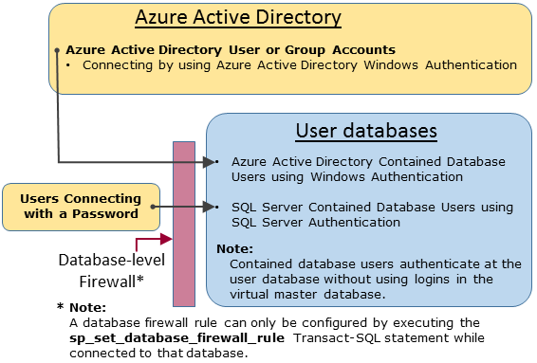
Non-administrator Access Path
Notes:
Non-administrator access path
When the database-level firewall is properly configured, the database users can connect using client tools such as SQL Server Management Studio or SQL Server Data Tools. Only the latest tools provide all the features and capabilities. The following diagram shows a typical non-administrator access path.

Slide 28
Groups and Roles
Azure Active Directory authentication
Put Azure Active Directory users into an Azure Active Directory group.
Create a contained database user for the group.
Place one or more database users into a database role.
Assign permissions to the database role.
SQL Server authentication
Create contained database users in the database.
Place one or more database users into a database role.
Assign permissions to the database role.
Notes:
Efficient access management uses permissions assigned to groups and roles instead of individual users. +
When using Azure Active Directory authentication, put Azure Active Directory users into an Azure Active Directory group. Create a contained database user for the group. Place one or more database users into a database role and then assign permissions to the database role.
When using SQL Server authentication, create contained database users in the database. Place one or more database users into a database role and then assign permissions to the database role.

Slide 29
Database Roles
The database roles can be the built-in roles such as:
db_owner
db_ddladmin
db_datawriter
db_datareader
db_denydatareader
db_denydatawriter
Notes:
The database roles can be the built-in roles such as db_owner, db_ddladmin, db_datawriter, db_datareader, db_denydatawriter, and db_denydatareader. db_owner is commonly used to grant full permission to only a few users. The other fixed database roles are useful for getting a simple database in development quickly, but are not recommended for most production databases. For example, the db_datareader fixed database role grants read access to every table in the database, which is usually more than is strictly necessary. It is far better to use the CREATE ROLE statement to create your own user-defined database roles and carefully grant each role the least permissions necessary for the business need. When a user is a member of multiple roles, they aggregate the permissions of them all.

Slide 30
Naming Requirements
Certain usernames are not allowed for security reasons. You cannot use the following names:
admin
administrator
guest
root
sa
Notes:
Certain user names are not allowed for security reasons.

Slide 31
Demonstration
Connect to an Azure SQL DB using SQL Authentication
Using SQL Login + SQL User.
Using Contained Database User.
Notes:
M04L03Demo01
Demo Requirements
- Use the script C:\Demos\M04L03Demo01\Connect_to_Azure_SQLDB.sql.
Step 1: Using SQL Login + SQL user (the most common and familiar option)
Follow the steps in the Using SQL Login + SQL User - Using Contained Database Users.sql script
Create SQL Login on master database (connect with admin account to master database)
Create SQL user on the master database (this is necessary for login attempt to the <default> database, as with Azure SQL you cannot set the DEFAULT_DATABASE property of the login so it always will be [master] database.)
Create SQL User on the user database (connect with admin account to user database)
Grant permissions to the user by assign him to a database role
Step 2: Using contained database user (SQL User with password, no login is involved)
Create SQL user with password on the user database (connect with admin account to user database)
Grant permissions to the user by assign him to a database role
Login with the newly created user:
With SSMS use the newly created user, make sure to set the database name of the user database you want to connect.
(you will not be able to connect to any other database on the same server as this user exists only on this specific database)

Slide 32
Questions?

Slide 33
Knowledge Check
Name the two unrestricted admin accounts for Azure SQL Database?
Name the Additional server-level administrative roles for Azure SQL Database?
Notes:
Question 1: Name the two unrestricted admin accounts for Azure SQL Database?
Answer 2: Server admin and Active Directory admin
Question 2: Name the Additional server-level administrative roles for Azure SQL database?
Answer 2: Database Creators (dbmanager) and Login Managers

Slide 34
Lesson 4: Implement Firewall Rules and Virtual Networks
Notes:
In this lesson we will be covering Firewall Rules and Virtual Networks

Slide 35
Objectives
After completing this learning, you will be able to:
Configure firewall rules on server and database level
Configure virtual networks on your logical SQL Server
Notes:
In this lesson we will be covering Firewall Rules and Virtual Networks

Slide 36
Securing your database with firewalls
Initially, all access to your Azure SQL Database server is blocked by the firewall.
In order to begin using your Azure SQL Database server, you must go to the Management Portal.
Server-level firewall rules enable clients to access all the databases within the same logical server.
Database-level firewall rules enable clients to access certain databases within the same logical server.
Database-level firewall rules for master and user databases can only be created and managed by using Transact-SQL statements and only after you have configured the first server-level firewall.
Microsoft recommends using database-level firewall rules whenever possible to enhance security and to make your database more portable.
Internet
Microsoft Azure
SQL Database firewall
Server-level firewall rules
Client IP address in range?
No
Database-level firewall rule for database 4
Client IP address in range?
No
Connection fails
Yes
Yes
DB 1
DB 2
DB 3
DB 4
Database with a database-level firewall rule
SQL Database Server
Windows Azure Platform
Notes:
Initially, all Transact-SQL access to your Azure SQL Server is blocked by the firewall. To begin using your Azure SQL Server, you must specify one or more server-level firewall rules that enable access to your Azure SQL server. Use the firewall rules to specify which IP address ranges from the Internet are allowed, and whether Azure applications can attempt to connect to your Azure SQL Server. Of course, you still need a login and password to authenticate.
To selectively grant access to just one of the databases in your Azure SQL Server, you must create a database-level rule for the required database. Specify an IP address range for the database firewall rule that is outside the IP address range specified in the server-level firewall rule, and ensure that the IP address of the client falls in the range specified in the database-level rule.
Server-level firewall rules: These rules enable clients to access your entire Azure SQL Server, that is, all the databases within the same logical server. These rules are stored in the master database. Server-level firewall rules can be configured by using the portal or by using Transact-SQL statements. To create server-level firewall rules using the Azure portal or PowerShell, you must be the subscription owner or a subscription contributor. To create a server-level firewall rule using Transact-SQL, you must connect to the SQL Database instance as the server-level principal login or the Azure Active Directory administrator (which means that a server-level firewall rule must first be created by a user with Azure-level permissions).
Database-level firewall rules: These rules enable clients to access certain (secure) databases within the same logical server. You can create these rules for each database (including the master database) and they are stored in the individual databases. Database-level firewall rules for master and user databases can only be created and managed by using Transact-SQL statements and only after you have configured the first server-level firewall. If you specify an IP address range in the database-level firewall rule that is outside the range specified in the server-level firewall rule, only those clients that have IP addresses in the database-level range can access the database. You can have a maximum of 128 database-level firewall rules for a database. For more information on configuring database-level firewall rules, see sp_set_database_firewall_rule (Azure SQL Databases).
Recommendation: Microsoft recommends using database-level firewall rules whenever possible to enhance security and to make your database more portable. Use server-level firewall rules for administrators and when you have many databases that have the same access requirements and you don't want to spend time configuring each database individually.

Slide 37
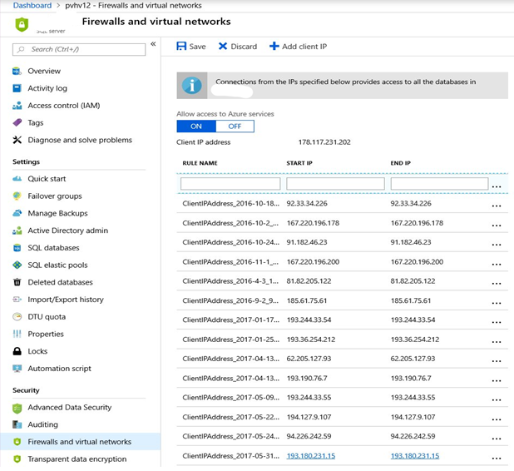
Firewall configuration using portal
By default, Azure blocks all external connections to port 1433.
Enable in the following ways in Azure portal:
Security -> Firewall and virtual networks
Notes:
The firewall restricts incoming traffic to TCP port 1433 only. In addition, by default, all external (from the Azure point of view) connections are blocked, so you need to explicitly enable them by specifying the public IP address (or IP address range) assigned to your Internet entry point.

Slide 38
Firewall configuration using PowerShell/T-SQL
Manage SQL Database firewall rules using code
Windows PowerShell Azure cmdlets
Get-AzSqlServerFirewallRule
New-AzSqlServerFirewallRule
Set-AzSqlServerFirewallRule
Remove-AzSqlServerFirewallRule
Transact SQL
sys.firewall_rules
sp_set_firewall_rule
sp_delete_firewall_rule
sys.database_firewall_rules
sp_set_database_firewall_rule
sp_delete_database_firewall_rule
# PS Enable Azure connections
PS C:\>New-AzSqlServerFirewallRule -ResourceGroupName "ResourceGroup01" -ServerName "Server01" -FirewallRuleName "Rule01" -StartIpAddress "192.168.0.198" -EndIpAddress "192.168.0.199"
# PS Allow external IP access to SQL Database
PS C:\> New-AzureSqlDatabaseServerFirewallRule -ServerName “Server01" -RuleName "FirewallRule" -StartIpAddress 10.1.1.1 -EndIpAddress 10.1.1.2
-- T-SQL Enable Azure connections
sp_set_firewall_rule N'Allow Windows Azure', '0.0.0.0','0.0.0.0'
-- T-SQL Allow external IP access to SQL Database
sp_set_firewall_rule N'myRule1', '12.1.1.1','12.1.1.2'
Notes:
Azure PowerShell
Get-AzSqlServerFirewallRule - Server level: Returns the current server-level firewall rules
New-AzSqlServerFirewallRule - Database level: Creates a firewall rule to allow access to all SQL Databases on the server from the entered IP address range.
Set-AzSqlServerFirewallRule - Server level: Updates the properties of an existing server-level firewall rule
Remove-AzSqlServerFirewallRule - Server level: Removes server-level firewall rules
Transact-SQL
sys.firewall_rules - Server level: Displays the current server-level IP firewall rules
sp_set_firewall_rule - Server level: Creates or updates server-level IP firewall rules
sp_delete_firewall_rule - Server level: Removes server-level IP firewall rules
sys.database_firewall_rules - Database level: Displays the current database-level IP firewall rules
sp_set_database_firewall_rule - Database level: Creates or updates the database-level IP firewall rules
sp_delete_database_firewall_rule - Database level: Removes database-level IP firewall rules

Slide 39
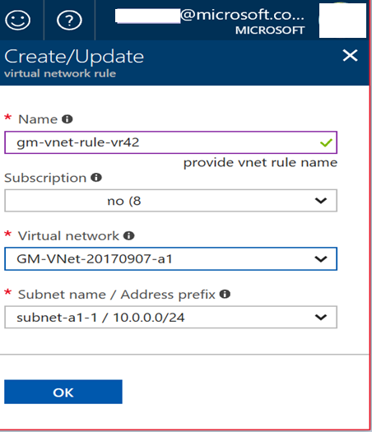
Virtual Network service endpoints
Allow access to Azure services
IP Rules
Only one geographic region
Server-level, not database-level
Notes:
Virtual network rules are one firewall security feature that controls whether your Azure SQL Database or SQL Data Warehouse server accepts communications that are sent from particular subnets in virtual networks.
A. Allow access to Azure services
The firewall pane has an ON/OFF button that is labeled Allow access to Azure services. The ON setting allows communications from all Azure IP addresses and all Azure subnets. These Azure IPs or subnets might not be owned by you. This ON setting is probably more open than you want your SQL Database to be. The virtual network rule feature offers much finer granular control.
B. IP rules
The SQL Database firewall allows you to specify IP address ranges from which communications are accepted into SQL Database. This approach is fine for stable IP addresses that are outside the Azure private network. But many nodes inside the Azure private network are configured with dynamic IP addresses. Dynamic IP addresses might change, such as when your VM is restarted. It would be folly to specify a dynamic IP address in a firewall rule, in a production environment.
You can salvage the IP option by obtaining a static IP address for your VM. For details, see Configure private IP addresses for a virtual machine by using the Azure portal.
However, the static IP approach can become difficult to manage, and it is costly when done at scale. Virtual network rules are easier to establish and to manage.
Only one geographic region
Each Virtual Network service endpoint applies to only one Azure region. The endpoint does not enable other regions to accept communication from the subnet.
Any virtual network rule is limited to the region that its underlying endpoint applies to.
Server-level, not database-level
Each virtual network rule applies to your whole Azure SQL Database server, not just to one particular database on the server. In other words, virtual network rule applies at the server-level, not at the database-level.
In contrast, IP rules can apply at either level.

Slide 40
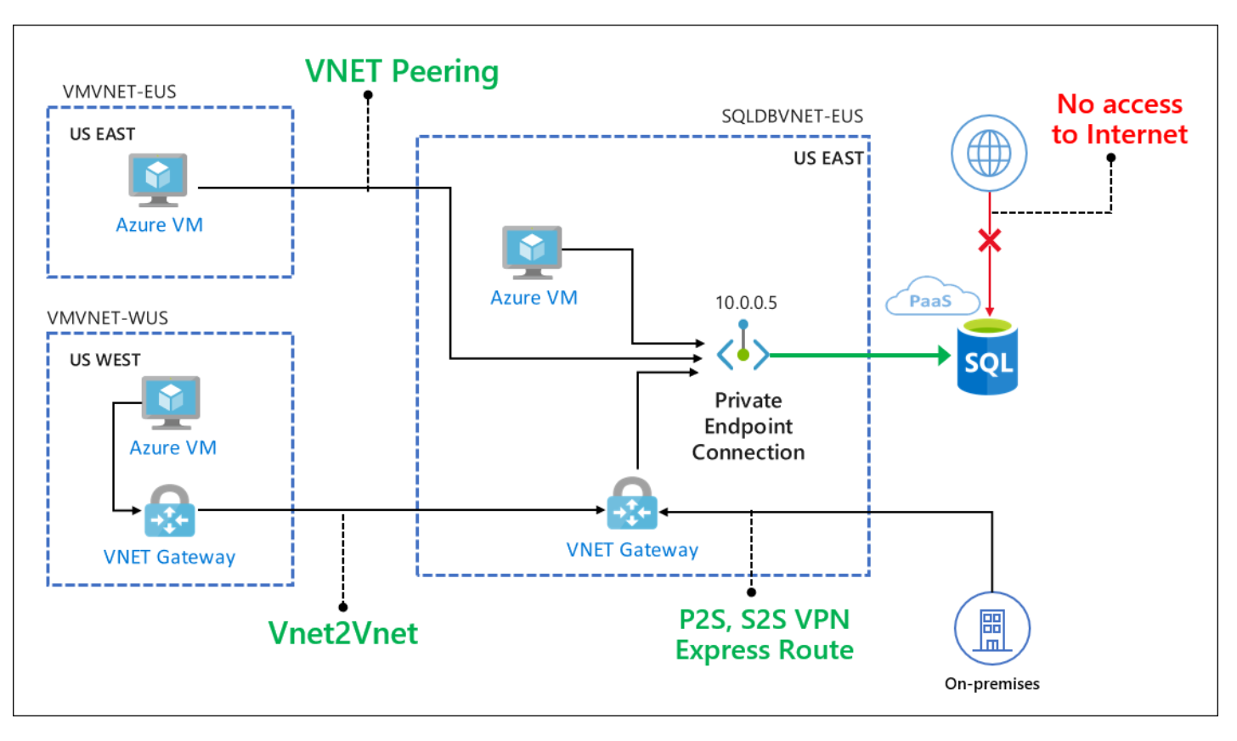
Private Link* for Azure SQL Database
Enable cross-premises access to the private endpoint using ExpressRoute, private peering, or VPN tunneling.
Subsequently all access via public endpoint can be disabled and not need to use the IP-based firewall.
Connection via a private endpoint, that is a private IP address within a specific VNet and Subnet.
*Private Link is currently in preview.
Notes:
Private Link allows you to connect to various PaaS services in Azure via a private endpoint. For a list to PaaS services that support Private Link functionality, go to the Private Link Documentation page. A private endpoint is a private IP address within a specific VNet and Subnet.
With Private Link, customers can now set up network access controls like NSGs to restrict access to the private endpoint. Individual Azure PaaS resources are then mapped to specific private endpoints. A malicious insider can only access the mapped PaaS resource (for example a SQL Database) and no other resource.
With Private Link, customers can enable cross-premises access to the private endpoint using ExpressRoute, private peering, or VPN tunneling. Customers can then disable all access via the public endpoint and not use the IP-based firewall to allow any IP addresses.
With Private Link, customers can enable cross-premises access to the private endpoint using Express Route (ER) private peering or VPN tunnel.They can subsequently disable all access via public endpoint and not use the IP-based firewall.

Slide 41
Questions?

Slide 42
Knowledge Check
True or False? Initially, all access to your Azure SQL Database server is blocked by the firewall?
Can you use the Azure Portal to configure database-level firewall rules?
Why should you use Virtual Network Service Endpoints?
Notes:
Q1: True or False? Initially, all access to your Azure SQL Database server is blocked by the firewall?
Answer 1:
Initially, all Transact-SQL access to your Azure SQL Server is blocked by the firewall. To begin using your Azure SQL Server, you must specify one or more server-level firewall rules that enable access to your Azure SQL Server. Use the firewall rules to specify which IP address ranges from the Internet are allowed, and whether Azure applications can attempt to connect to your Azure SQL Server.
Q2: Can you use the Azure Portal to configure database-level firewall rules?
Answer 2:
No. Database-level firewall rules for master and user databases can only be created and managed by using Transact-SQL statements and only after you have configured the first server-level firewall.
Q3: Why should you use Virtual Network Service Endpoints?
Answer 3:
Virtual network rules are one firewall security feature that controls whether your Azure SQL Database or SQL Data Warehouse server accepts communications that are sent from particular subnets in virtual networks.

Slide 43
Lesson 5: Implement Transparent Data Encryption
Notes:
In this lesson we will be covering Transparent Data Encryption.

Slide 44
Objectives
After completing this learning, you will be able to:
Know how to secure data at rest using Transparent Data Encryption.
Notes:
In this lesson we will be covering Transparent Data Encryption.

Slide 45
Understanding TDE Functionality
Data is encrypted at rest.
Encryption keys are managed by Azure.
Performs real-time I/O encryption and decryption of the data at the page level.
Each page is decrypted when it's read into memory and then encrypted before being written to disk.
TDE is enabled for all newly deployed Azure SQL Databases.
No need for application change.
Support for equality operations (including joins) on encrypted data.
Bring You Own Key (BYOK) supported.
SQL Database
Notes:
Transparent data encryption (TDE) helps protect Azure SQL Database and Azure Data Warehouse against the threat of malicious activity. It performs real-time encryption and decryption of the database, associated backups, and transaction log files at rest without requiring changes to the application. By default, TDE is enabled for all newly deployed Azure SQL Databases. TDE cannot be used to encrypt the logical master database in SQL Database. The master database contains objects that are needed to perform the TDE operations on the user databases.
TDE will need to be manually enabled for older databases or Azure SQL Data Warehouse.
Transparent data encryption encrypts the storage of an entire database by using a symmetric key called the database encryption key. This database encryption key is protected by the transparent data encryption protector. The protector is either a service-managed certificate (service-managed transparent data encryption) or an asymmetric key stored in Azure Key Vault (Bring Your Own Key). You set the transparent data encryption protector at the server level.
On database startup, the encrypted database encryption key is decrypted and then used for decryption and re-encryption of the database files in the SQL Server Database Engine process. Transparent data encryption performs real-time I/O encryption and decryption of the data at the page level. Each page is decrypted when it's read into memory and then encrypted before being written to disk.
Key points:
Fully managed by Azure
Support for user-managed TDE using Azure Key Vault planned (strict NDA)
Total Data Encryption with Always Encrypted for better performance
All cert/key management handled by Azure SQL
Simple Interface
Single SQL Statement/API call to enable/disable
Predictable Encryption Performance
Uses Azure SQL Database’s editions to ensure predictable performance
AES-NI Hardware Acceleration
Intel’s AES-NI support in TDE means better performance and better value
Reference: https://docs.microsoft.com/en-us/azure/sql-database/transparent-data-encryption-byok-azure-sql?view=sql-server-2017

Slide 46
Encryption Keys
Service-managed transparent data encryption
The database encryption key is protected by a built-in server certificate.
Unique for each server.
Primary and geo-secondary database are protected by the primary database's parent server key.
Microsoft automatically rotates these certificates at least every 90 days.
Bring Your Own Key
Take control over your transparent data encryption keys and control who can access them and when.
Azure Key Vault.
You set the asymmetric key at the server level, and all databases under that server inherit it.
You can control key management tasks such as key rotations and key vault permissions.
Notes:
Service-managed transparent data encryption
In Azure, the default setting for transparent data encryption is that the database encryption key is protected by a built-in server certificate. The built-in server certificate is unique for each server. If a database is in a geo-replication relationship, both the primary and geo-secondary database are protected by the primary database's parent server key. If two databases are connected to the same server, they share the same built-in certificate. Microsoft automatically rotates these certificates at least every 90 days.
Microsoft also seamlessly moves and manages the keys as needed for geo-replication and restores.
Bring Your Own Key
With Bring Your Own Key support, you can take control over your transparent data encryption keys and control who can access them and when. Key Vault, which is the Azure cloud-based external key management system, is the first key management service that transparent data encryption has integrated with Bring Your Own Key support. With Bring Your Own Key support, the database encryption key is protected by an asymmetric key stored in Key Vault. The asymmetric key never leaves Key Vault. After the server has permissions to a key vault, the server sends basic key operation requests to it through Key Vault. You set the asymmetric key at the server level, and all databases under that server inherit it.
With Bring Your Own Key support, you now can control key management tasks such as key rotations and key vault permissions. You also can delete keys and enable auditing/reporting on all encryption keys. Key Vault provides central key management and uses tightly monitored hardware security modules (HSM). Key Vault promotes separation of management of keys and data to help meet regulatory compliance.

Slide 47
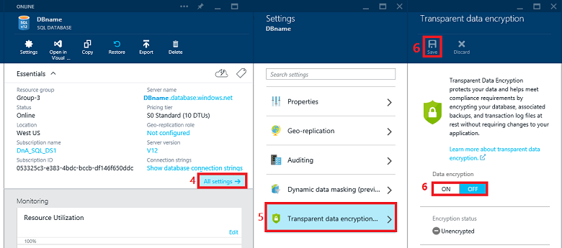
Enable TDE Using Azure Portal
Notes:
To configure TDE through the Azure portal, you must be connected as the Azure Owner, Contributor, or SQL Security Manager.
You set TDE on the database level. To enable TDE on a database, go to the Azure portal and sign in with your Azure Administrator or Contributor account. Find the TDE settings under your user database blade. By default, service-managed TDE is used. A TDE certificate is automatically generated for the server that contains the database.

Slide 48
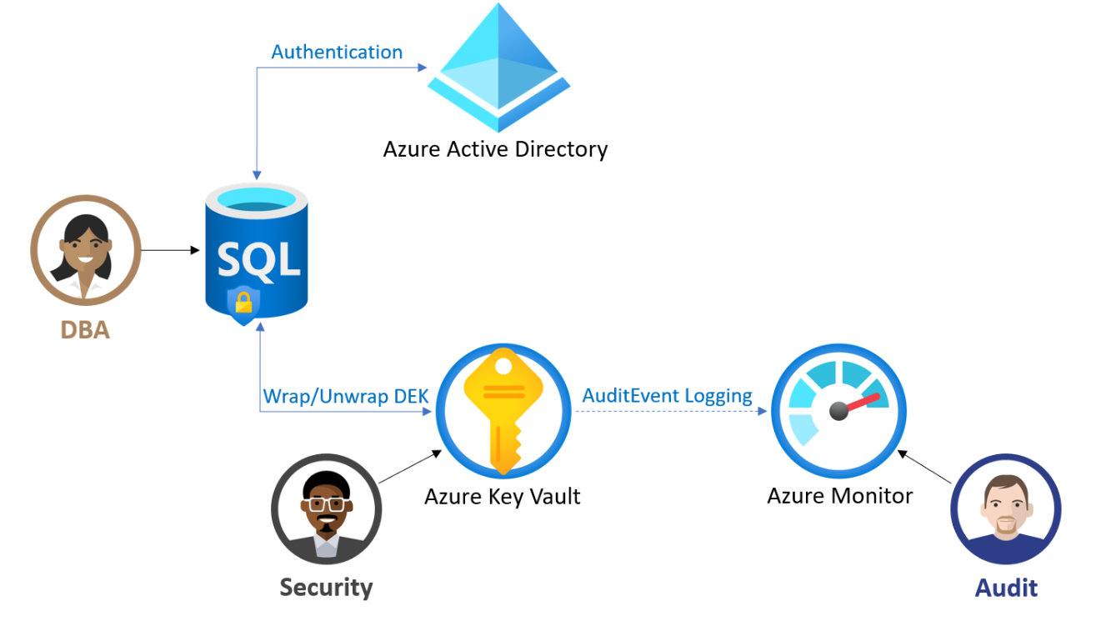
TDE with customer-managed key (BYOK)
You are responsible for and in a full control of a key lifecycle management (key creation, upload, rotation, deletion), key usage permissions, and auditing of operations on keys.
The key used for encryption of the Database Encryption Key (DEK), called TDE protector, is a customer-managed asymmetric key stored in a customer-owned and customer-managed Azure Key Vault (AKV), a cloud-based external key management system.
TDE protector is set at the logical server level and is inherited by all encrypted databases associated with that server.
Notes:
Azure SQL Transparent Data Encryption (TDE) with customer-managed key enables Bring Your Own Key (BYOK) scenario for data protection at rest, and allows organizations to implement separation of duties in the management of keys and data. With customer-managed transparent data encryption, customer is responsible for and in a full control of a key lifecycle management (key creation, upload, rotation, deletion), key usage permissions, and auditing of operations on keys.
In this scenario, the key used for encryption of the Database Encryption Key (DEK), called TDE protector, is a customer-managed asymmetric key stored in a customer-owned and customer-managed Azure Key Vault (AKV), a cloud-based external key management system. Key Vault is highly available and scalable secure storage for RSA cryptographic keys, optionally backed by FIPS 140-2 Level 2 validated hardware security modules (HSMs). It doesn't allow direct access to a stored key, but provides services of encryption/decryption using the key to the authorized entities. The key can be generated by the key vault, imported, or transferred to the key vault from an on-prem HSM device.
Benefits of the customer-managed TDE
Customer-managed TDE provides the following benefits to the customer:
Full and granular control over usage and management of the TDE protector;
Transparency of the TDE protector usage;
Ability to implement separation of duties in the management of keys and data within the organization;
Key Vault administrator can revoke key access permissions to make encrypted database inaccessible;
Central management of keys in AKV;
Greater trust from your end customers, since AKV is designed such that Microsoft cannot see nor extract encryption keys;

Slide 49
Demonstration
Implement TDE using Azure Portal and T-SQL Code
Enable TDE With Bring Your Own Key using Azure Portal.
Notes:
M04L05Demo01
In this demo you will show how you can enable TDE with the Bring Your Own Key option. Since we do not have our own key, we’re going to generate a new one in Azure Key Vault.
Demo Requirements
Your logical server that you have created in Module 1
Make sure that GEO-Replication is NOT turned on for the Salesdb
Demo Steps:
Open the Azure Portal, go to you logical server and select Transparent Data Encryption
Use your own key – select Yes
Click Select a key
Click on Key Vault and Create a new Vault
Name – Enter a unique for the Vault
Select your subscription
Use the existing Resource Group that you have created during Module 1
Leave the location to the default location
Pricing Tier – Standard
Soft-delete – Enable recovery of this vault and it's object
Access Policies – Leave the default, only your user
Virtual Networks – All networks can access
Create Key Vault
Go to Key Vault just created and click Keys
Configure the following settings for the key
Options – Generate
Name – Provide a name for the key
Key Type – RSA
RSA Key Size – 2048
Do not set an activation or expiration date
Enabled? – Yes
Once the Key vault and the key are provisioned, click save to enable TDE with your own key

Slide 50
Questions?

Slide 51
Knowledge Check
Does TDE encrypt the data in motion?
What kind of application changes are required to use TDE?
Which 2 types of Encryption Keys can be used for TDE?
Notes:
Q1: Does TDE encrypt the data in motion?
Answer 1: No, it encrypts data only at rest.
Q2: What kind of application changes are required to use TDE?
Answer 2: There are no application changes required for this feature.
Q3: Which 2 types of Encryption Keys can be used for TDE?
Answer 3: Service-managed TDE and Bring Your Own Key

Slide 52
Lesson 6: Implement Always Encrypted
Notes:
In this lesson we will be covering Always Encrypted

Slide 53
Objectives
After completing this learning, you will be able to:
Know how to secure data at rest and in motion using Always encrypted.
Notes:
In this lesson we will be covering Always Encrypted

Slide 54
Always Encrypted
Always Encrypted allows clients to encrypt sensitive data inside client applications and never reveal the encryption keys to SQL Database.
As a result, Always Encrypted provides a separation between those who own the data (and can view it) and those who manage the data (but should have no access).
Notes:
Always Encrypted provides an end-to-end encryption solution which encrypts sensitive data at rest and in motion. It enables you to protect your data from everyone, including administrators, while allowing access to data owners who need to use the sensitive data.

Slide 55
Understanding Always Encrypted Functionality
Data remains encrypted during query
Capability
Transparent client-side encryption, while SQL Server executes T-SQL queries on encrypted data.
Benefits
Sensitive data remains encrypted and query-able at all times.
Unauthorized users never have access to data or keys.
No changes to applications are necessary.
Apps
Encrypted query
TDE-enabled ADO.NET library
SQL Server
No app changes
Encrypted columnar key
Notes:
Always Encrypted allows clients to encrypt sensitive data inside client applications and never reveal the encryption keys to the database engine (SQL Database or SQL Server). As a result, Always Encrypted provides a separation between those who own the data (and can view it) and those who manage the data (but should have no access). By ensuring on-premises database administrators, cloud database operators, or other high-privileged, but unauthorized users, cannot access the encrypted data, Always Encrypted enables customers to confidently store sensitive data outside of their direct control. This allows organizations to encrypt data at rest and in use for storage in Azure, to enable delegation of on-premises database administration to third parties, or to reduce security clearance requirements for their own DBA staff.
Always Encrypted makes encryption transparent to applications. An Always Encrypted-enabled driver installed on the client computer achieves this by automatically encrypting and decrypting sensitive data in the client application. The driver encrypts the data in sensitive columns before passing the data to the database engine, and automatically rewrites queries so that the semantics to the application are preserved. Similarly, the driver transparently decrypts data, stored in encrypted database columns, contained in query results.

Slide 56
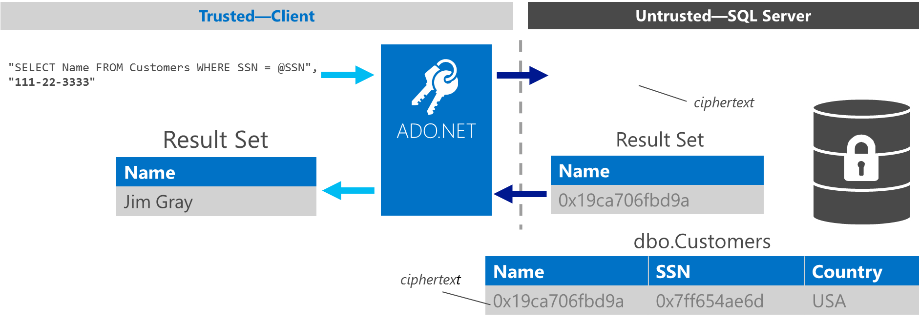
Understanding Always Encrypted Functionality (Contd.)
"SELECT Name FROM Customers WHERE SSN = @SSN",
0x7ff654ae6d
Notes:
The driver encrypts the data in sensitive columns before passing the data to SQL Server, and automatically rewrites queries so that the semantics to the application are preserved. Similarly, the driver transparently decrypts data, stored in encrypted database columns, contained in query results. Here are the details on how these feature works:
Users specify individual columns of particular tables to be encrypted
Once encrypted, the data appears as an encrypted binary blob at all stages within the SQL Server database: on disk, in memory, during computations, and over the network
Users use a certificate store to save the encryption key.
Both encryption and decryption are done by the ADO.Net SqlClient driver for .Net 4.6. This driver will require access to the encryption key (via the certificate store, generally) and thereafter will communicate with the SQL Server directly to effect transparent encryption.
Specifically, when queries are parameterized, SqlClient will handshake with the SQL Server and identify which parameters are encrypted and will manage this process in both directions.
Example: the client code specifies a select statement with the parameter “where SSN = @SSN” and provides the parameter value “@SSN=’123-45-6789′” and the driver itself intercepts the parameter value and properly encrypts it

Slide 57
Encryption Methodologies
Randomized encryption
Encrypt('123-45-6789') = 0x17cfd50a
Repeat: Encrypt('123-45-6789') = 0x9b1fcf32
Allows for transparent retrieval of encrypted data but no operations.
More secure
Deterministic encryption
Encrypt('123-45-6789') = 0x85a55d3f
Repeat: Encrypt('123-45-6789') = 0x85a55d3f
Allows for transparent retrieval of encrypted data and quality.
Comparison (for example, in WHERE clauses and joins, distinct, group by).
Two types of encryption are available:
Randomized encryption uses a method that encrypts data in less predictable manner.
Deterministic encryption uses method that always generates the same encrypted value for any given plain text value.
Notes:
Randomized encryption uses a method that encrypts data in a less predictable manner. Randomized encryption is more secure, but prevents equality searches, grouping, indexing, and joining on encrypted columns.
Deterministic encryption uses a method that always generates the same encrypted value for any given plain text value. Using deterministic encryption allows grouping, filtering by equality, and joining tables based on encrypted values, but can also allow unauthorized users to guess information about encrypted values by examining patterns in the encrypted column. This weakness is increased when there is a small set of possible encrypted values, such as true/false, or north/south/east/west region. Deterministic encryption must use a column collation with a binary2 sort order for character columns.
Use deterministic encryption for columns that will be used as search or grouping parameters, for example, a government ID number. Use randomized encryption for data such as confidential investigation comments—which are not grouped with other records or used to join tables—from the row that contains the encrypted column of interest.

Slide 58
Enabling Always Encrypted on Azure SQL DB
Create a local, self-signed certificate on the development machine, which will act as a Column Master Key (CMK). The CMK will be used to protect Column Encryption Keys (CEK), which encrypts the sensitive data.
Create a CMK store definition object in the database, which will store the information about the location of the CMK. The certificate will never be copied to the database or SQL Server machine.
Create a Column Encryption Key (CEK). You use column encryption keys to encrypt data in database columns.
Create a table with encrypted columns.
DB (Database side)
Notes:
On the Database-side, here are the steps for enabling Always Encrypted displayed on the slide.
SQL Server Management Studio (SSMS) has an “Encrypt Columns” wizard which will perform these steps for you interactively or by generating a PowerShell script to run later.

Slide 59
Enabling Always Encrypted on Azure SQL DB (contd.)
Same local stored certificate.
“Column Encryption Setting=Enabled;”
in connection string.
Make sure you use the correct driver.
Client Side
Notes:
On the Client-side, here are the steps for enabling Always Encrypted displayed on the slide.

Slide 60
Demonstration
Enable Always Encrypted
Enable Always Encrypted
Select data through Application.
Notes:
M04L06Demo01
In this demo, we first are going to insert a bunch of records in the Employees table of the salesdb
Secondly, you will enable Always Encrypted on the table Employees
Finally, you will connect with a .NET demo tool to the database to prove that Always Encrypted is working
Demo Requirements
The salesdb that has been created during Module 1
Use the file C:\Demos\M04L06Demo01\AlwaysEncryptedClient.Zip
Use the file C:\Demos\M04L06Demo01\Insert Employees in Employees Table.sql
Demo 1 – Insert records in Employees table
Open the SSMS and connect to your salesdb.
Execute the script “Insert Employees in Employees Table”
Demo 2 – Enable Always Encrypted
In the SSMS, go to you database salesdb → Security → Always Encrypted
Right click Column Master Key and select “New Column Master Key”
Click the button “Generate Certificate” and give the CMK. Click OK
In the SSMS, go to you database salesdb → Security → Always Encrypted
Right click Column Encryption Key and select “New Column Encryption Key”
Specify the name CEK and select the CMK that you have just created
Go to your database salesdb → Table Employees, right click on the table and select Encrypt Columns
Select the column LastName and choose the encryption Type Deterministic. Notice that the Encryption Key is already filled in with CEK
Click next and proceed to Finish now. Wait until the encryption is finished… (I have noticed that it can take a few minutes to encrypt…)
Execute the following statement so proof to the students that the columns are encrypted
SELECT TOP (1000) [EmployeeID] ,[FirstName] ,[MiddleInitial] ,[LastName] FROM [dbo].[Employees]
Demo 3 – Use the tool so that you can show the decrypted column
Open the tool Always Encrypted Demo Client.
Change the connection string so that the tool connects to your logical server, the salesdb, … Make sure you use the parameter Column Encryption Setting=Enabled in your connection string
Execute the following query in the tool
SELECT TOP (1000) [EmployeeID] ,[FirstName] ,[MiddleInitial] ,[LastName] FROM [dbo].[Employees]
Notice that the column lastname is not encrypted.

Slide 61

Implement Always Encrypted
Exercise 1: Implement Always Encrypted on Azure SQL Database.
Exercise 2: Use the .Net Client App to Test Always Encrypted.
Notes:
M04L06Lab01

Slide 62
Always Encrypted - Challenges
Many applications require support for queries that do more than equality comparison.
Data needs to be moved out of the database for initial encryption and key rotation.

Slide 63
Questions?

Slide 64
Knowledge Check
Can a DBA see Always Encrypted data?
What are the 4 steps that you need to perform to enable Always Encrypted?
Notes:
Q1: Can a DBA see Always Encrypted data?
Answer 1: No, the data will be stored in the database as encrypted format. The decrypted data will only be visible from the application. Unless the DBA has the certificate installed on his/her client PC
Q2: What are the 4 steps that you need to perform to enable Always Encrypted?
Answer 2:
Create a local, self-signed certificate on the development machine, which will act as a Column Master Key (CMK).
Create a CMK store definition object in the database
Create a Column Encryption Key (CEK).
Create a table with encrypted columns.
Column Master Key (CMK). The CMK will be used to protect Column Encryption Keys (CEK)

Slide 65
Lesson 7: Implement Row Level Security
Notes:
In this lesson we will be covering Row Level Security

Slide 66
Objectives
After completing this learning, you will be able to:
Know how to control access to the data using Row Level Security (RLS).
Notes:
In this lesson we will be covering Row Level Security

Slide 67
Row Level Security (RLS)
Row-Level Security enables customers to control access to rows in a database table based on the characteristics of the user executing a query.
Notes:
Row Level Security is a feature of SQL Server 2016 and above and included in Azure SQL Database V12.0. It allows you to set up security policies to control access to rows within a table based on the user accessing the data.

Slide 68
Understanding RLS Functionality
Fine-grained access control over specific rows in a database table.
Helps to prevent unauthorized access when multiple users share the same tables, or to implement connection filtering in multitenant applications.
Enforcement logic inside the database and schema is bound to the table.
Customer 1
Customer 2
Customer 3
SQL Database
Notes:
RLS enables customers to control access to rows in a database table based on the characteristics of the user executing a query (e.g., group membership or execution context).
RLS simplifies the design and coding of security in your application. RLS enables you to implement restrictions on data row access. For example ensuring that workers can access only those data rows that are pertinent to their department, or restricting a customer's data access to only the data relevant to their company.
The access restriction logic is located in the database tier rather than away from the data in another application tier. The database system applies the access restrictions every time that data access is attempted from any tier. This makes your security system more reliable and robust by reducing the surface area of your security system.

Slide 69
RLS Implementation details
Predicate function
User-defined inline table-valued function (iTVF) implementing security logic
Can be arbitrarily complicated, containing joins with other tables.
Security predicate
Binds a predicate function to a particular table, applying it for all queries.
Two types: filter predicates and blocking predicates.
Security policy
Collection of security predicates for managing security across multiple tables.
Performance?
Inline functions get optimized to provide comparable performance to views, as if the logic were directly embedded in the original query statement
CREATE SECURITY POLICY mySecurityPolicy
ADD FILTER PREDICATE dbo.fn_securitypredicate(wing, startTime, endTime)
ON dbo.patients
Notes:
Three core concepts are used in Row-Level Security: predicate function, security predicate, and security policy.
Predicate function: Row-level filtering of data selected from a table is enacted through a security predicate filter defined as a user-defined, inline table-valued function (iTVF) implementing security logic (for example, returning a row or not, depending on the principal name, role, or other attributes of the calling user).
Security predicate: Binds a predicate function to a particular table, applying it for all queries (for example, applying a function that checks for the rep name or rep manager role to an Accounts table). RLS supports two types of security predicates: filter predicates and block predicates.
Filter predicates silently filter the rows available to read operations (SELECT, UPDATE, and DELETE).
Block predicates explicitly block write operations (AFTER INSERT, AFTER UPDATE, BEFORE UPDATE, BEFORE DELETE) that violate the predicate.
Security policy: This is a collection of security predicates for managing security across multiple tables. (For example, you might have an Account policy that applies multiple security predicates to Account-related tables, and an HR policy that applies several security predicates to various HR tables.)
Access to row-level data in a table is restricted by a security predicate defined as an inline table-valued function. The function is then invoked and enforced by a security policy.
For filter predicates, there is no indication to the application that rows have been filtered from the result set; if all rows are filtered, a null set will be returned. For block predicates, any operations that violate the predicate will fail with an error.
Filter predicates are applied while reading data from the base table, and this affects all get operations: SELECT, DELETE (that is, user cannot delete rows that are filtered), and UPDATE (that is, user cannot update rows that are filtered, although it is possible to update rows in such a way that they will be subsequently filtered).
Block predicates affect all write operations.
AFTER INSERT and AFTER UPDATE predicates can prevent users from updating rows to values that violate the predicate.
BEFORE UPDATE predicates can prevent users from updating rows that currently violate the predicate.
BEFORE DELETE predicates can block delete operations.
The function is then invoked and enforced by a security policy. The policy can restrict the rows that may be viewed (a filter predicate), but does not restrict the rows that can be inserted or updated from a table (a blocking predicate). There is no indication to the application that rows have been filtered from the result set; if all rows are filtered, a null set will be returned.
Even dbo/db_owner/table owner queries against a table that has a security policy defined and enabled has rows filtered/restricted as appropriate.
Any attempt to modify the table schema or the function that is used as the filter predicate within an active policy enabled will result in error.

Slide 70
Demonstration
Implement RLS using T-SQL Code
Enable RLS using T-SQL.
Notes:
M04L07Demo01
Demo Requirements
Make sure you have the salesdb that was created in Module 1
Use the C:\Demos\M04L07Demo01\Row Level Security.sql file.
Demo – Follow the steps in the Row Level Security.sql script
Create Table
Insert Data into the table
Create Users
Grant permissions to the users
Create the predicate function
Create the security policy
Verify data with Sales1 user
Verify data with Sales2 user
Verify data with Manager user

Slide 71
Implement Row Level Security
Exercise 1: Implement Row Level Security on Azure SQL Database.
Notes:
M04L07Lab01

Slide 72
Questions?

Slide 73
Knowledge Check
What is the purpose of the predicate function?
Why do we need row level security (RLS)?
Notes:
Q1: What is the purpose of the predicate function?
Answer 1: It's a user defined inline TVF implementing security logic.
Q2: Why do we need row level security (RLS)?
Answer 2: It helps to prevent unauthorized access to the data when multiple users access the same set of tables.

Slide 74
Lesson 8: Implement Dynamic Data Masking
Notes:
In this lesson we will be covering Dynamic Data Masking

Slide 75
Objectives
After completing this learning, you will be able to:
Know how to mask the critical data using Dynamic Data Masking.
Notes:
In this lesson we will be covering Dynamic Data Masking

Slide 76
Dynamic Data Masking
Dynamic Data Masking is a policy-based security feature that helps to limit the exposure of data in a database by returning masked data to non-privileged users who run queries over designated database fields.
Notes:
Dynamic Data Masking enables you to hide parts of data fields upon display in an application. It will allow you to mask certain data columns based on built-in or custom policies.

Slide 77
Understanding Dynamic Data Masking Functionality
Prevent abuse of sensitive data by hiding it from users.
Easy configuration in new Azure Portal.
Policy-driven at table and column level, for a defined set of users.
Data masking applied in real-time to query results based on policy.
Multiple masking functions available, such as full or partial, for various sensitive data categories (credit card numbers, SSN, etc.).
Table.RegistrationID
25487541
85475892
78548354
SQL Database
Real-time data masking, partial masking
RegistrationID
XXXX7541
XXXX5892
Notes:
Dynamic data masking limits sensitive data exposure by masking it to non-privileged users. Dynamic data masking helps prevent unauthorized access to sensitive data by enabling administrators to designate how much of the sensitive data to reveal with minimal impact on the application layer. It’s a policy-based security feature that hides the sensitive data in the result set of a query over designated database fields, while the data in the database is not changed. Dynamic data masking is easy to use with existing applications, since masking rules are applied in the query results, and there is no need to modify existing queries.
For example, a call center support person may identify callers by several digits of their social security number or credit card number, but those data items should not be fully exposed to the support person. A developer can define a masking rule to be applied to each query result that masks all but the last four digits of any social security number or credit card number in the result set. For another example, by using the appropriate data mask to protect personally identifiable information (PII) data, a developer can query production environments for troubleshooting purposes without violating compliance regulations.
Dynamic data masking limits the exposure of sensitive data and prevents accidental viewing by engineers that access databases directly for troubleshooting purposes. Dynamic data masking doesn’t aim to prevent privileged database users from connecting directly to the database and running exhaustive queries that expose pieces of the sensitive data. Dynamic data masking is complimentary to other SQL Server security features (auditing, encryption, row level security…) and it is highly recommended to enable them in addition in order to protect the sensitive data in the database.

Slide 78
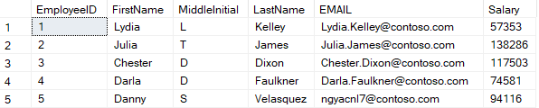
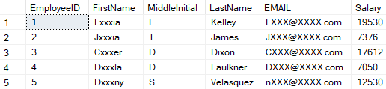
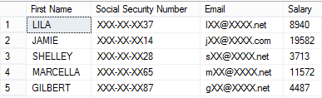
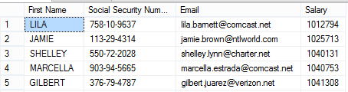
Enable Dynamic Data Masking on Azure SQL DB
admin1 logon
other logon
Security officer defines dynamic data masking policy in T-SQL over sensitive data in the Employee table.
The app user selects from the Employee table.
The dynamic data masking policy obfuscates the sensitive data in the query results.
ALTER TABLE dbo.Employee
ALTER COLUMN [FirstName] ADD MASKED WITH (FUNCTION = 'partial(1, "xxx", 2)')
ALTER TABLE dbo.Employee
ALTER COLUMN [EMAIL] ADD MASKED WITH (FUNCTION = 'email()')
ALTER TABLE dbo.Employee
ALTER COLUMN [Salary] ADD MASKED WITH (FUNCTION = 'random(2000,20000)’)
GRANT UNMASK to admin1
Security officer
Business app
SELECT EmployeeID, FirstName, MiddleInitial, LastName, EMAIL, Salary
FROM [Employee]
Other Login
Admin Login
Notes:
There are 5 types of masks available
1. Default ->Full masking according to the data types of the designated fields: • Use XXXX or fewer Xs if the size of the field is less than 4 characters for string data types (nchar, ntext, nvarchar). • Use a zero value for numeric data types (bigint, bit, decimal, int, money, numeric, smallint, smallmoney, tinyint, float, real). • Use 01-01-1900 for date/time data types (date, datetime2, datetime, datetimeoffset, smalldatetime, time). • For SQL variant, the default value of the current type is used. • For XML the document is used. • Use an empty value for special data types (timestamp table, hierarchyid, GUID, binary, image, varbinary spatial types).
2. Credit Card → Masking method, which exposes the last four digits of the designated fields and adds a constant string as a prefix in the form of a credit card. XXXX-XXXX-XXXX-1234
3. Email → Masking method which exposes the first letter of an email address and the constant suffix ".com", in the form of an email address. . aXXX@XXXX.com.
4. Random → A random masking function for use on any numeric type to mask the original value with a random value within a specified range.
5. Custom String → Masking method which exposes the first and last letters and adds a custom padding string in the middle. prefix,[padding],suffix
Note: If the original value is too short to complete the entire mask, part of the prefix or suffix will not be exposed.
Note: When you use the portal, you will get recommendations on mask type. Therefore, sometimes can be easier to set up the masking using the portal instead of T-SQL.

Slide 79
Demonstration
Implement Dynamic Data masking T-SQL Code
Enable Dynamic Data masking using T-SQL.
Notes:
M04L08Demo01
Demo Requirements
Make sure you have the salesdb that was created in Module 1
Use C:\Demos\M04L08Demo01\Dynamic Data Masking.sql file.
Demo – Follow the steps in the Dynamic Data Masking.sql script
Create Table
Insert Data into the table
Create Users
Grant permissions to the users
Execute a select statement as the test user
Modify a column with another masking function
Rerun the select statement as the test user.

Slide 80
Questions?

Slide 81
Knowledge Check
What’s the purpose of Dynamic Data Masking?
List two different masking rules in Dynamic Data Masking?
Notes:
Answer 1: Dynamic Data Masking is a policy-based security feature that helps to limit the exposure of data in a database by returning masked data to non-privileged users who run queries over designated database fields.
Answer 2: Any two of: Email, Default, Custom Text, Random, Credit Card

Slide 82
Lesson 9: Implement Auditing for Azure SQL Database
Notes:
In this lesson we will be covering Auditing for Azure SQL Database

Slide 83
Objectives
After completing this learning, you will be able to:
Know how you can configure Auditing on Azure SQL Database.
Notes:
In this lesson we will be covering Auditing for Azure SQL Database

Slide 84
SQL Auditing
SQL Auditing tracks database events and writes them to an audit log in your Azure storage account, Log Analytics workspace or Event Hubs.
Helps you maintain regulatory compliance, understand database activity, and gain insight into discrepancies and anomalies that could indicate business concerns or suspected security violations.
Enables and facilitates adherence to compliance standards, although it doesn't guarantee compliance.
Notes:
Azure SQL Database Auditing tracks database events and writes them to an audit log in your Azure Storage account.
Auditing can help you maintain regulatory compliance, understand database activity, and gain insight into discrepancies and anomalies that could indicate business concerns or suspected security violations.
SQL Database Auditing allows you to:
Retain an audit trail of selected events. You can define categories of database actions to be audited.
Report on database activity. You can use preconfigured reports and a dashboard to get started quickly with activity and event reporting.
Analyze reports. You can find suspicious events, unusual activity, and trends.

Slide 85
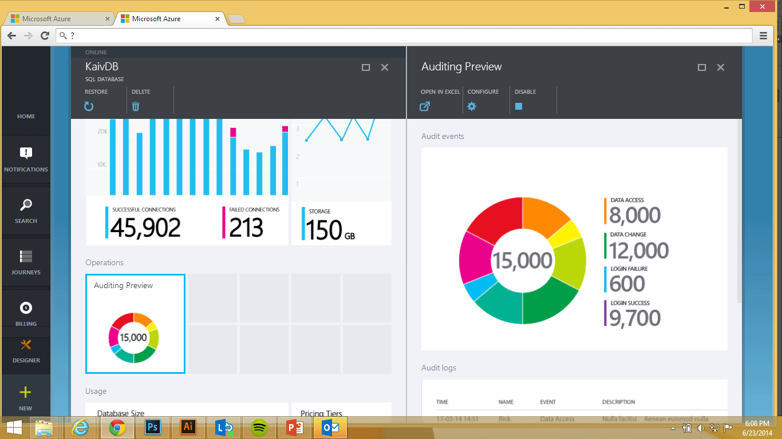
SQL Auditing (continued)
Gain insight into database events and streamline compliance-related tasks.
Configurable to track and log database activity.
Dashboard views in portal for at-a-glance insights.
Audit logs reside Azure Storage Account, Log Analytics or Event Hub.
Available in Basic, Standard, Premium and Managed Instance.
The default auditing policy includes:
BATCH_COMPLETED_GROUP
SUCCESSFUL_DATABASE_AUTHENTICATION_GROUP
FAILED_DATABASE_AUTHENTICATION_GROUP
Audit log
SQL
Azure storage
SQL Database
Auditing
Application data
Notes:
You now have multiple options for configuring where audit logs will be written. You can write logs to:
Azure storage account,
Log Analytics workspace for consumption by Azure Monitor logs,
event hub for consumption using event hub.
You can configure any combination of these options, and audit logs will be written to each.
Warning
Enabling auditing to Log Analytics will incur cost based on ingestion rates. Please be aware of the associated cost with using this option, or consider storing the audit logs in an Azure storage account.
When audit logs are written to Append Blobs in Azure Blob storage on your Azure subscription.
All storage kinds (v1, v2, blob) are supported.
All storage replication configurations are supported.
Premium storage is currently not supported.
Storage in VNet is currently not supported.
Storage behind a Firewall is currently not supported.
Hierarchical namespace for Azure Data Lake Storage Gen2 storage account is currently not supported.
The default auditing policy includes all actions and the following set of action groups, which will audit all the queries and stored procedures executed against the database, as well as successful and failed logins:
BATCH_COMPLETED_GROUP SUCCESSFUL_DATABASE_AUTHENTICATION_GROUP FAILED_DATABASE_AUTHENTICATION_GROUP
You can configure auditing for different types of actions and action groups using PowerShell, as described in the Manage SQL database auditing using Azure PowerShell section.

Slide 86
Analyze audit logs and reports
Azure Monitor logs
Azure portal
Event Hub
Avro Tools or similar tools
Azure storage account
Azure Storage Explorer
SQL Server Management Studio (SSMS)
PowerShell
Azure portal
Power BI
Notes:
If you chose to write audit logs to Azure Monitor logs:
Use the Azure portal. View audit logs.
Clicking on Log Analytics at the top of the Audit records page will open the Logs view in Log Analytics workspace, where you can customize the time range and the search query. Or access it directly from Log Analytics blade.
If you chose to write audit logs to Event Hub:
To consume audit logs data from Event Hub, you will need to set up a stream to consume events and write them to a target. To read the audit logs, you can use Avro Tools or similar tools that process this format.
If you chose to write audit logs to an Azure storage account, there are several methods you can use to view the logs:
Using a tool such as Azure Storage Explorer. In Azure storage, auditing logs are saved as a collection of blob files within a container named sqldbauditlogs.
Use the Azure portal. Open the relevant database. At the top of the database's Auditing page, click View audit logs.
Use Power BI. You can view and analyze audit log data in Power BI.
Download log files from your Azure Storage blob container via the portal or by using a tool such as Azure Storage Explorer. After you have downloaded a log file locally, double-click the file to open, view, and analyze the logs in SSMS.
Query Extended Events Files by using PowerShell.

Slide 87
Demonstration
Implement Auditing for Azure SQL Database
Enable auditing for Azure SQL Database using Azure portal.
Notes:
M04L09Demo01
Demo Requirements
The salesdb that has been created in Module 1
SSMS
Steps:
Open the Azure Portal and open the salesdb
Click Auditing
Enable Auditing
Specify a storage account to store the audit logs
Specify a retention period. For example 30 days
Click save
Open the SSMS and execute the following statement
SELECT TOP (1000) [EmployeeID]
,[FirstName]
,[MiddleInitial]
,[LastName]
FROM [dbo].[Employees]
Go back to the portal and click the button “View Audit Logs”
You will notice that there are a few logs already available.
Search for you query in the logs. The type will be BATCH COMPLETED and is typically the last log record
Show the audit record details

Slide 88
Questions?

Slide 89
Knowledge Check
Which 3 action groups are configured by default when you enable auditing?
Where are the auditing records stored?
Which tools can you use to analyze the Audit Logs?
Notes:
Q1: Which 3 action groups are configured by default when you enable auditing?
Answer 1: The default auditing policy includes all actions and the following set of action groups, which will audit all the queries and stored procedures executed against the database, as well as successful and failed logins:
BATCH_COMPLETED_GROUP SUCCESSFUL_DATABASE_AUTHENTICATION_GROUP FAILED_DATABASE_AUTHENTICATION_GROUP
Q2: Where are the auditing records stored?
Answer 2: Azure blob storage, Log Analytics and Event Hub
Q3: Which tools can you use to analyze the Audit Logs?
Answer 3:
Azure Storage Explorer
Sync Application with Log Analytics
SQL Server Management Studio
Power BI

Slide 90
Lesson 10: Implement Advanced Data Security
Notes:
In this lesson we will be covering Advanced Threat Protection

Slide 91
Objectives
After completing this learning, you will be able to:
Know how to proactively identify security threats like SQL Injection or anomalous SQL login by enabling threat detection
Know how to discover, classify, label & protect the sensitive data in your databases
Know how to discover, track, and help you remediate potential database vulnerabilities
Notes:
In this lesson we will be covering Advanced Threat Protection

Slide 92
Advanced Data Security (ADS)
Advanced Data Security (ADS) offering, which is a unified package for advanced SQL security capabilities, including:
Data discovery & classification
Vulnerability
All these capabilities can be accessed and managed via the central SQL ADS portal.
Advanced Threat Protection

Slide 93
Advanced Threat Detection
Advanced Threat Protection for single and pooled databases detects anomalous activities indicating unusual and potentially harmful attempts to access or exploit databases.
Advanced Threat Protection can identify:
Potential SQL injection, Access from unusual location or data center.
Access from unfamiliar principal or potentially harmful application.
Brute force SQL credentials.
Notes:
Advanced Threat Detection detects anomalous activities indicating unusual and potentially harmful attempts to access or exploit your database. It continuously monitors your database for suspicious activities, and provides immediate security alerts on potential vulnerabilities, SQL injection attacks, and anomalous database access patterns. Threat Detection alerts provide details of the suspicious activity and recommend action on how to investigate and mitigate the threat.

Slide 94
Advanced Threat Detection (continued)
Detect anomalous database activities that could indicate a potential threat.
Configure threat detection policy in Azure Portal.
Receive alerts from multiple database threat detectors that identify anomalous activities.
Explore audit log around the time of an event.
External attacker
SQL
Threat detection
Web app
Azure SQL Database
Malicious insider
Alert
Notes:
Advanced Threat Detection detects anomalous activities indicating unusual and potentially harmful attempts to access or exploit your database. It continuously monitors your database for suspicious activities, and provides immediate security alerts on potential vulnerabilities, SQL injection attacks, and anomalous database access patterns. Threat Detection alerts provide details of the suspicious activity and recommend action on how to investigate and mitigate the threat.

Slide 95
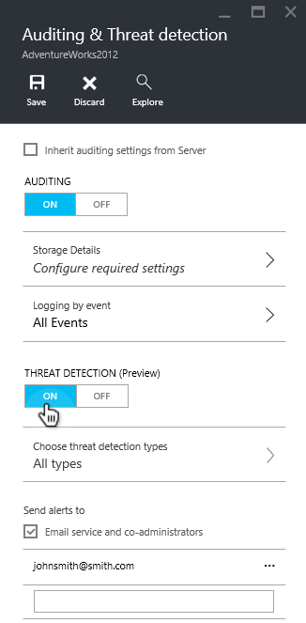
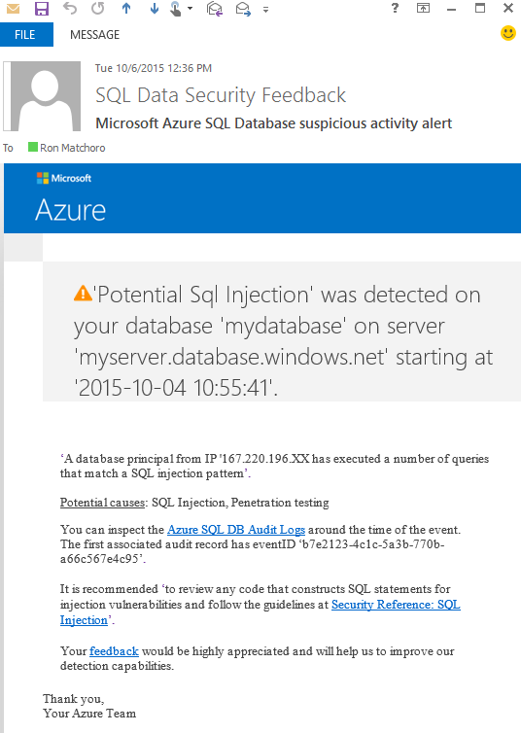
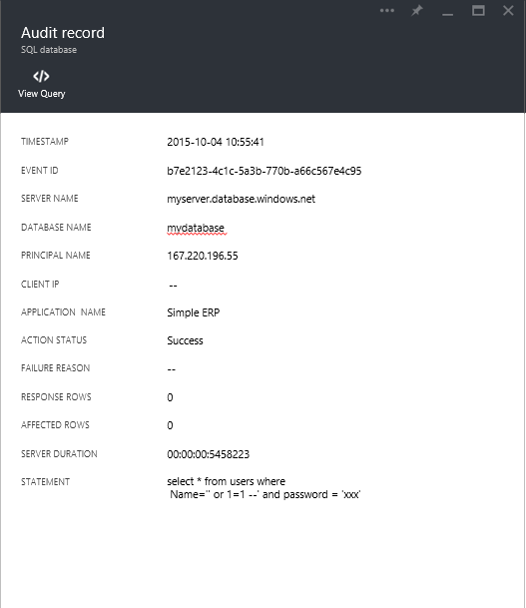
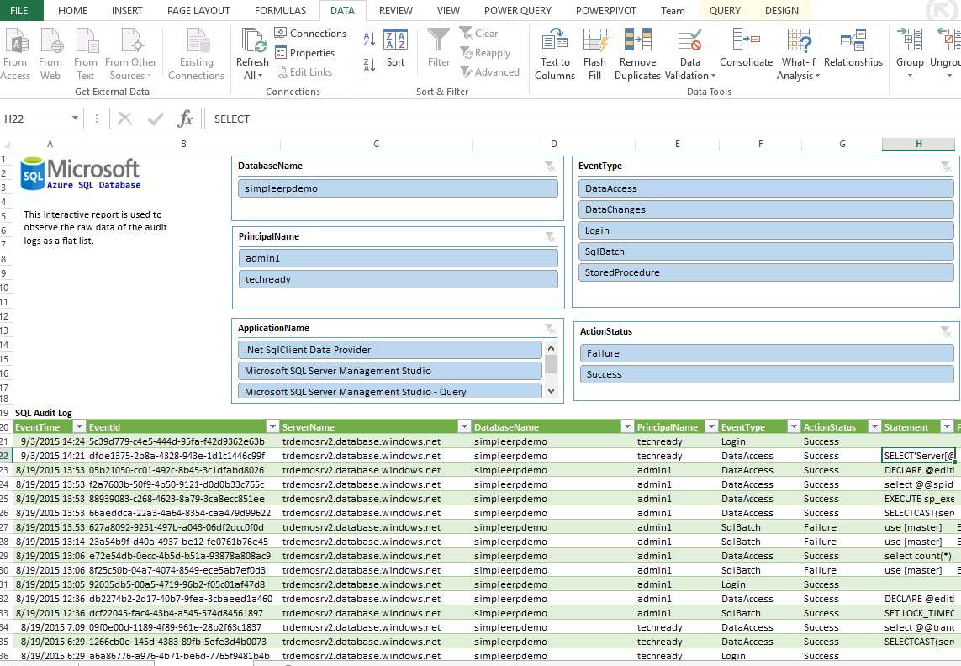

How Threat Detection Works
Set up
Alert
Explore
Notes:
Set up threat detection for your database in the Azure portal
Launch the Azure portal at https://portal.azure.com.
Navigate to the configuration page of the Azure SQL Database server you want to protect. In the security settings, select Advanced Data Security.
On the Advanced Data Security configuration page:
Enable Advanced Data Security on the server.
In Threat Detection Settings, in the Send alerts to text box, provide the list of emails to receive security alerts upon detection of anomalous database activities.
Explore anomalous database activities upon detection of a suspicious event
You receive an email notification upon detection of anomalous database activities. The email provides information on the suspicious security event including the nature of the anomalous activities, database name, server name, application name, and the event time. In addition, the email provides information on possible causes and recommended actions to investigate and mitigate the potential threat to the database.
Explore threat detection alerts for your database in the Azure portal
SQL Database Threat Detection integrates its alerts with Azure Security Center. A live SQL threat detection tile within the database in the Azure portal tracks the status of active threats.
Click Threat detection alert to launch the Azure Security Center alerts page and get an overview of active SQL threats detected on the database.

Slide 96
Azure SQL Database Threat Detection Alerts
Vulnerability to SQL Injection
Potential SQL Injection
Access from unusual location
Access from unusual Azure data center
Access from unfamiliar principal
Access from a potentially harmful application
Brute force SQL credentials
Notes:
Listed on the slide are the common threats that are detected by Azure SQL Database which can be used to alert administrators of potential attacks.

Slide 97
Demonstration
Threat Detection for Azure SQL Database
Enable Threat Detection for Azure SQL Database.
Notes:
M04L10Demo01
Demo Requirements
The Logical server that has been created in Module 1
Steps:
Open the Azure Portal and open the logical server
Click Advanced Data Security
Enable Advanced Data Security
Select Threat Detection Types

Slide 98
Data Discovery and Classification
Data discovery & classification provides advanced capabilities built into Azure SQL Database for discovering, classifying, labeling & protecting the sensitive data in your databases.
Notes:
Data Discovery & Classification provides advanced capabilities built into Azure SQL Database for discovering, classifying, labeling & protecting the sensitive data in your databases. Discovering and classifying your most sensitive data (business, financial, healthcare, etc.) can play a pivotal role in your organizational information protection stature. It can serve as infrastructure for:
Helping meet data privacy standards and regulatory compliance requirements.
Various security scenarios, such as monitoring (auditing) and alerting on anomalous access to sensitive data.
Controlling access to and hardening the security of databases containing highly sensitive data.
Data Discovery & Classification is part of the Advanced Data Security offering, which is a unified package for advanced SQL security capabilities. Data Discovery & Classification can be accessed and managed via the central Azure portal.
Discovery & recommendations – The classification engine scans your database and identifies columns containing potentially sensitive data. It then provides you an easy way to review and apply the appropriate classification recommendations via the Azure portal.
Labeling – Sensitivity classification labels can be persistently tagged on columns using new classification metadata attributes introduced into the SQL Engine. This metadata can then be utilized for advanced sensitivity-based auditing and protection scenarios.
Query result set sensitivity – The sensitivity of query result set is calculated in real time for auditing purposes.
Visibility - The database classification state can be viewed in a detailed dashboard in the portal. Additionally, you can download a report (in Excel format) to be used for compliance & auditing purposes, as well as other needs.

Slide 99
Data Discovery and Classification (continued)
Discovery & recommendations
Labeling
Query result set sensitivity
Visibility
Auditing access to sensitive data
Notes:
Data Discovery & Classification provides advanced capabilities built into Azure SQL Database for discovering, classifying, labeling & protecting the sensitive data in your databases. Discovering and classifying your most sensitive data (business, financial, healthcare, etc.) can play a pivotal role in your organizational information protection stature. It can serve as infrastructure for:
Helping meet data privacy standards and regulatory compliance requirements.
Various security scenarios, such as monitoring (auditing) and alerting on anomalous access to sensitive data.
Controlling access to and hardening the security of databases containing highly sensitive data.
Data Discovery & Classification is part of the Advanced Data Security offering, which is a unified package for advanced SQL security capabilities. Data Discovery & Classification can be accessed and managed via the central Azure portal.
Discovery & recommendations – The classification engine scans your database and identifies columns containing potentially sensitive data. It then provides you an easy way to review and apply the appropriate classification recommendations via the Azure portal.
Labeling – Sensitivity classification labels can be persistently tagged on columns using new classification metadata attributes introduced into the SQL Engine. This metadata can then be utilized for advanced sensitivity-based auditing and protection scenarios.
Query result set sensitivity – The sensitivity of query result set is calculated in real time for auditing purposes.
Visibility - The database classification state can be viewed in a detailed dashboard in the portal. Additionally, you can download a report (in Excel format) to be used for compliance & auditing purposes, as well as other needs.
Auditing access to sensitive data
An important aspect of the information protection paradigm is the ability to monitor access to sensitive data. Azure SQL Database Auditing has been enhanced to include a new field in the audit log called data_sensitivity_information, which logs the sensitivity classifications (labels) of the actual data that was returned by the query

Slide 100
Demonstration
Data Discovery and Classification
Classify your SQL Database.
Notes:
M04L10Demo02
Demo Requirements
Salesdb that has been created in Module 1
Remark
Phone# will return an error, probably because of the #-symbol in the name of the column
Steps
1. Go to the Azure portal.
2. Navigate to Advanced Data Security under the Security heading in your Azure SQL Database pane. Click to enable Advanced Data Security, and then click on the Data discovery & classification (preview) card.
3. The Overview tab includes a summary of the current classification state of the database, including a detailed list of all classified columns, which you can also filter to view only specific schema parts, information types and labels. If you haven’t yet classified any columns go to step 4
4. To begin classifying your data, click on the Classification tab at the top of the window.
5. The classification engine scans your database for columns containing potentially sensitive data and provides a list of recommended column classifications. To view the list of recommended column classifications, click on the recommendations panel at the bottom of the window:
6. To apply the selected recommendations, click on the blue Accept selected recommendations button.
7. You can also manually classify columns as an alternative, or in addition, to the recommendation-based classification:
Click on Add classification in the top menu of the window.
In the context window that opens, select the schema > table > column that you want to classify, and the information type and sensitivity label. Then click on the blue Add classification button at the bottom of the context window.
8. To complete your classification and persistently label (tag) the database columns with the new classification metadata, click on Save in the top menu of the window.
***note:

Slide 101
SQL Vulnerability Assessment
SQL Vulnerability Assessment is an easy to configure service that can discover, track, and help you remediate potential database vulnerabilities. Use it to proactively improve your database security.
Notes:
SQL Vulnerability Assessment (VA) is a service that provides visibility into your security state, and includes actionable steps to resolve security issues, and enhance your database security. It can help you:
Meet compliance requirements that require database scan reports.
Meet data privacy standards.
Monitor a dynamic database environment where changes are difficult to track.
VA is a scanning service built into the Azure SQL Database service. The service employs a knowledge base of rules that flag security vulnerabilities and highlight deviations from best practices, such as misconfigurations, excessive permissions, and unprotected sensitive data. The rules are based on Microsoft’s best practices and focus on the security issues that present the biggest risks to your database and its valuable data. They cover both database-level issues as well as server-level security issues, like server firewall settings and server-level permissions. These rules also represent many of the requirements from various regulatory bodies to meet their compliance standards.
Results of the scan include actionable steps to resolve each issue and provide customized remediation scripts where applicable. An assessment report can be customized for your environment by setting an acceptable baseline for permission configurations, feature configurations, and database settings.

Slide 102
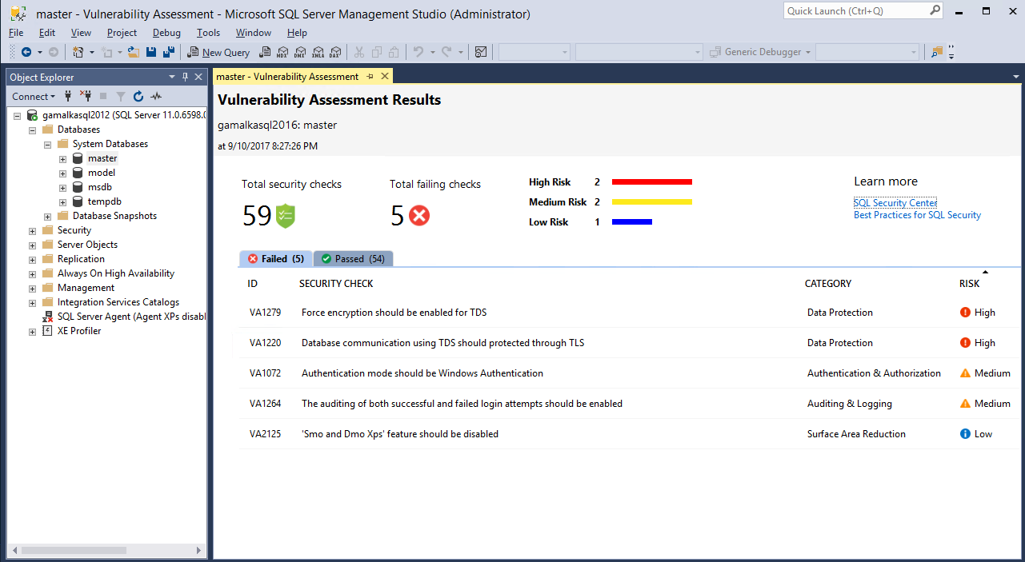
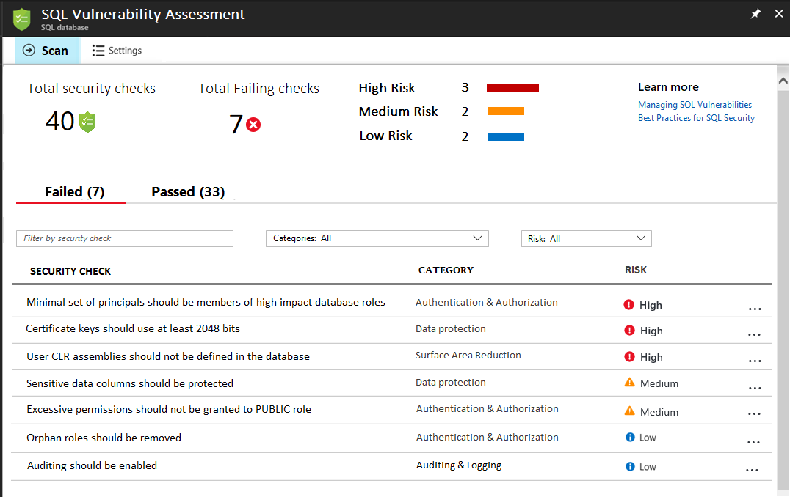
SQL Vulnerability Assessment (continued)
Get visibility
Discover sensitive data and potential security holes.
Remediate
Actionable remediation and security hardening steps.
Customize
Baseline policy tuned to your environment, allowing you to focus on deviations.
Report
Pass internal or external audits to facilitate compliance.
SQL Server on-premises
Azure SQL Database
SQL
Identifies, tracks, and resolves SQL security vulnerabilities
Azure SQL Database
Vulnerability Assessment
Developer/DBA
Notes:
SQL Vulnerability Assessment (VA) is a service that provides visibility into your security state, and includes actionable steps to resolve security issues, and enhance your database security. It can help you:
Meet compliance requirements that require database scan reports.
Meet data privacy standards.
Monitor a dynamic database environment where changes are difficult to track.
VA is a scanning service built into the Azure SQL Database service. The service employs a knowledge base of rules that flag security vulnerabilities and highlight deviations from best practices, such as misconfigurations, excessive permissions, and unprotected sensitive data. The rules are based on Microsoft’s best practices and focus on the security issues that present the biggest risks to your database and its valuable data. They cover both database-level issues as well as server-level security issues, like server firewall settings and server-level permissions. These rules also represent many of the requirements from various regulatory bodies to meet their compliance standards.
Results of the scan include actionable steps to resolve each issue and provide customized remediation scripts where applicable. An assessment report can be customized for your environment by setting an acceptable baseline for permission configurations, feature configurations, and database settings.

Slide 103
Using Vulnerability Assessment
Run a scan
Built-in scanning service.
1
Detect deviations
Subsequent scans will alert on deviations from your baseline.
2
View a report
All-up assessment of security state.
6
5
3
Drill-down to results
View detailed results and understand how they impact database security.
Set a baseline
Customize scan requirements based on your environment.
4
Remediate issues
Run scripts that resolve vulnerabilities directly within the report.
Notes:
1. Get started with VA by navigating to Advanced Data Security under the Security heading in your Azure SQL Database pane. Click to enable Advanced Data Security, and then click on the Vulnerability Assessment card, which automatically opens the Vulnerability Assessment settings card.
Start by configuring a storage account where your scan results will be stored. For information about storage accounts, see About Azure storage accounts. Once storage is configured, click Scan to scan your database for vulnerabilities.
2. View the report
When your scan is complete, your scan report is automatically displayed in the Azure portal. The report presents an overview of your security state: how many issues were found and their respective severities. Results include warnings on deviations from best practices and a snapshot of your security-related settings, such as database principals and roles and their associated permissions.The scan report also provides a map of sensitive data discovered in your database, and includes recommendations to classify that data using Data Discovery & Classification.
3-4. Analyze the results and resolve issues
Review your results and determine the findings in the report that are true security issues in your environment. Drill down to each failed result to understand the impact of the finding and why each security check failed. Use the actionable remediation information provided by the report to resolve the issue.
5. Set your baseline
As you review your assessment results, you can mark specific results as being an acceptable Baseline in your environment. The baseline is essentially a customization of how the results are reported. Results that match the baseline are considered as passing in subsequent scans. Once you have established your baseline security state, VA only reports on deviations from the baseline and you can focus your attention on the relevant issues.
6. Run a new scan to see your customized tracking report
After you complete setting up your Rule Baselines, run a new scan to view the customized report. VA now reports only the security issues that deviate from your approved baseline state.
7. Set up periodic recurring scans
Navigate to the Vulnerability Assessment settings to turn on Periodic recurring scans. This configures Vulnerability Assessment to automatically run a scan on your database once per week. A scan result summary will be sent to the email address(es) you provide.

Slide 104
Demonstration
Vulnerability Assessment
Run a scan, review the report and set a baseline.
Notes:
M04L10Demo03
Demo Requirements
Salesdb that has been created in Module 1
An Azure Storage account
SSMS
Execute the following statement on the salesdb
ALTER ROLE [db_owner] ADD MEMBER [guest]
Step 1: Run a scan
Get started with VA by navigating to Advanced Threat Protection under the Security heading in your Azure SQL Database pane.
Click to enable Advanced Threat Protection, and then click on the Vulnerability Assessment card, which automatically opens the Vulnerability Assessment settings card.
Configure your storage account
Once storage is configured, click Scan to scan your database for vulnerabilities. The scan is lightweight and safe. It takes a few seconds to run, and is entirely read-only. It does not make any changes to your database.
Step 2: View the report
Explore the issues and explain them to the students. When your scan is complete, your scan report is automatically displayed in the Azure portal. The report presents an overview of your security state: how many issues were found and their respective severities.
You will see that the “Server principal GUEST should not be a member of any role” issue is shown as high risk
Step3: Analyze and resolve
Click on the Server principal GUEST should not be a member of any role issue and look at Remediation
Resolve the issue by executing the SQL Statement that is suggested in the remediation script
Run the scan again and you will notice that the issue is gone
Click on the scan history button to show the history of each scan

Slide 105
Vulnerability Assessment
Exercise 1: Run a scan, review the report and set a baseline.
Notes:
M04L10Lab01

Slide 106
Questions?

Slide 107
Knowledge Check
List one important event type captured in threat detection.
Where are the threat detection records stored?
What are the steps to implement a Vulnerability Assessment?
Notes:
Q1: List one important event type captured in threat detection.
Answer 1:
Potential SQL Injection
Access from unusual location
Access from unusual Azure data center
Access from unfamiliar principal
Access from a potentially harmful application
Brute force SQL credentials
Q2: Where are the threat detection records stored?
Answer 2: Azure blob storage
Q3: What are the steps to implement a Vulnerability Assessment?
Answer 3:
Run a Scan
View the report
Remediate issues
Set a baseline
Detect deviations

Slide 108
Module Summary
Introduction to Azure SQL Database Security
Implement Azure Active Directory Security
Manage Logins in Azure SQL Database
Implement Firewall Rules and Virtual Networks
Implement Transparent Data Encryption
Implement Always Encrypted
Implement Row Level Security
Implement Dynamic Data Masking
Implement Auditing for Azure SQL Database
Implement Advanced Data Security

